Slide 1



ORGANISING DATA

Slide 2

AGENDA
Importance of Organizing Data
Unions
Views
Temporary Tables
CTEs
Best Practices

Slide 3
Importance of Organizing Data

Slide 4
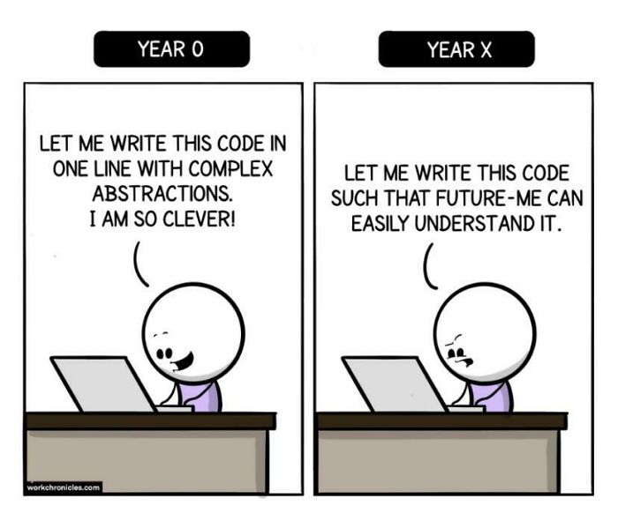
IMPORTANCE OF ORGANIZING DATA
To make code more understandable for yourself and for others
To improve readability and maintainability
To help in error handling and debugging

Slide 5
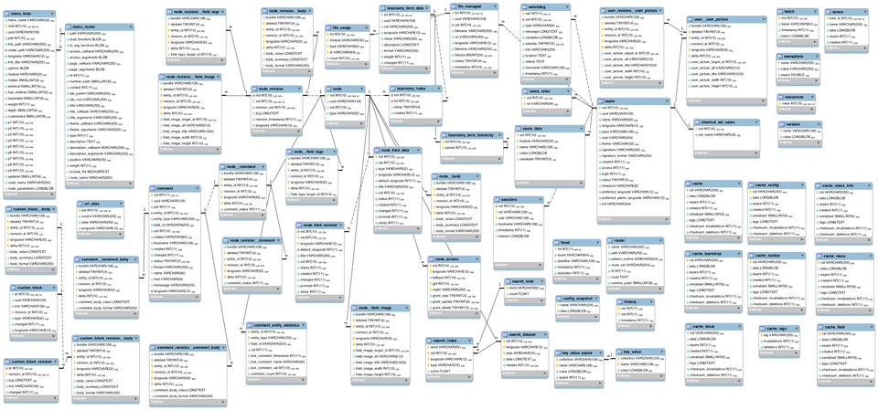
IMPORTANCE OF ORGANIZING DATA

Slide 6
WHAT IS ORGANIZED DATA?
?
Logical
High integrity
Consistent
Well-documented
Structured
Notes:
Logical – some logic behind the organization
High Integrity – no errors
Consistent – naming of tables/columns/variables (identation in queries)
Structured – normalized tables
Well-documented – purpose of each table/column, what each row represents, what connections between tables represent

Slide 7
WHAT IS ORGANIZED DATA?
Analytics
Ingestion
Transformation
Serving
Generation
Machine Learning
Storage
Reverse ETL
Security
Data Management
DataOps
Data Architecture
Software Engineering

Slide 8
Union

Slide 9
REMEMBER THIS?
Kind of a Union
Kind of a Join
 | A | B | C
0
1
2
3
4
5
 | A | B | C
0
1
2
3
4
5
6
7
8
 | A | B
0
1
2
3
4
5
 | A | B | C | D | E
0
1
2
3
4
5
 | C | D | E
0
1
2
3
4
5
 | A | B | C
6
7
8

Slide 10
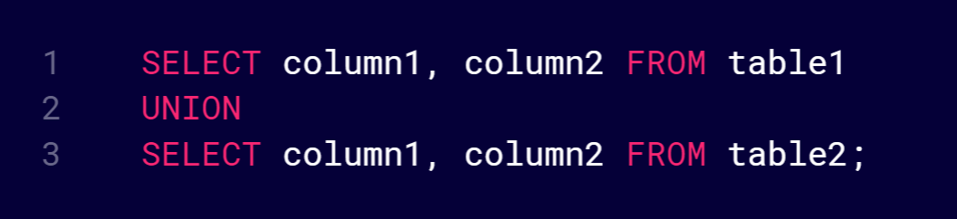
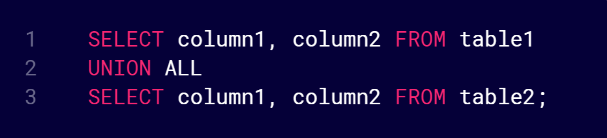
UNION / UNION ALL
Union
Union All
Combines distinct rows from two or more SELECT statements
Does not remove duplicated rows from the result set

Slide 11
UNION / UNION ALL
When to UNION:
Combining data from multiple tables
Merging data from multiple queries
Aggregating data from different sources
Same number of columns with compatible data types (column names can be different)
 | A | B | C
0
1
2
3
4
5
 | A | B | C
0
1
2
3
4
5
6
7
8
 | A | B | C
6
7
8
Notes:
For example: you have contact information for clients and suppliers

Slide 12
UNION
Combines distinct rows from two or more SELECT statements
id | subject
1 | math
2 | english
3 | history
4 | data analytics
5 | communication
6 | arts
id | subject
1 | math
2 | english
3 | history
4 | data analytics
id | subject
3 | history
4 | data analytics
5 | communication
6 | arts
+
=

Slide 13
UNION ALL
Does not remove duplicated rows from the result set
id | subject
1 | math
2 | english
3 | history
4 | data analytics
3 | history
4 | data analytics
5 | communication
6 | arts
id | subject
1 | math
2 | english
3 | history
4 | data analytics
id | subject
3 | history
4 | data analytics
5 | communication
6 | arts
+
=

Slide 14
COLUMN NAMES
ID | FirstName | LastName | Age
1 | Stevie | Nicks | 75
2 | Lindsey | Buckingham | 73
3 | John | McVie | 77
id | Name | Surname | AgeYears
4 | Mick | Jagger | 79
5 | Keith | Richards | 79
6 | Ronnie | Wood | 76
+
Data types of columns must be compatible
Number and order of columns must be same
Returns column names from first query
Notes:
Data type compatibility details: https://www.postgresql.org/docs/current/typeconv-union-case.html

Slide 15
COLUMN NAMES
ID | FirstName | LastName | Age
1 | Stevie | Nicks | 75
2 | Lindsey | Buckingham | 73
3 | John | McVie | 77
4 | Mick | Jagger | 79
5 | Keith | Richards | 79
6 | Ronnie | Wood | 76

Slide 16
Let’s practice Unions!

Slide 17
Views

Slide 18



VIEWS
Notes:
Not this!

Slide 19
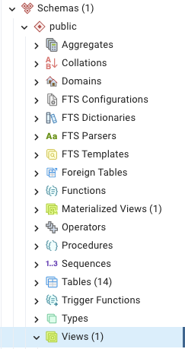

VIEWS
“Virtual” tables, allow you to:
Simplify complex queries
Make data more consistent
Improve performance
Notes:
Views are stored in the DB and can be made available to others

Slide 20
VIEWS
DATABASE
TABLES
…
VIEWS
…
API
T1
V1
T2
V2
Notes:
E.g. no need for clients / other team members to write complex queries and access tables directly as they can access views

Slide 21



CREATING VIEWS
Non-materialized
Materialized
Computed on query
“live”
Stored on disk
Static until refreshed
Notes:
Materialized views are not available in some SQL “flavours”, e.g. in MySQL

Slide 22
Let’s practice Views!

Slide 23
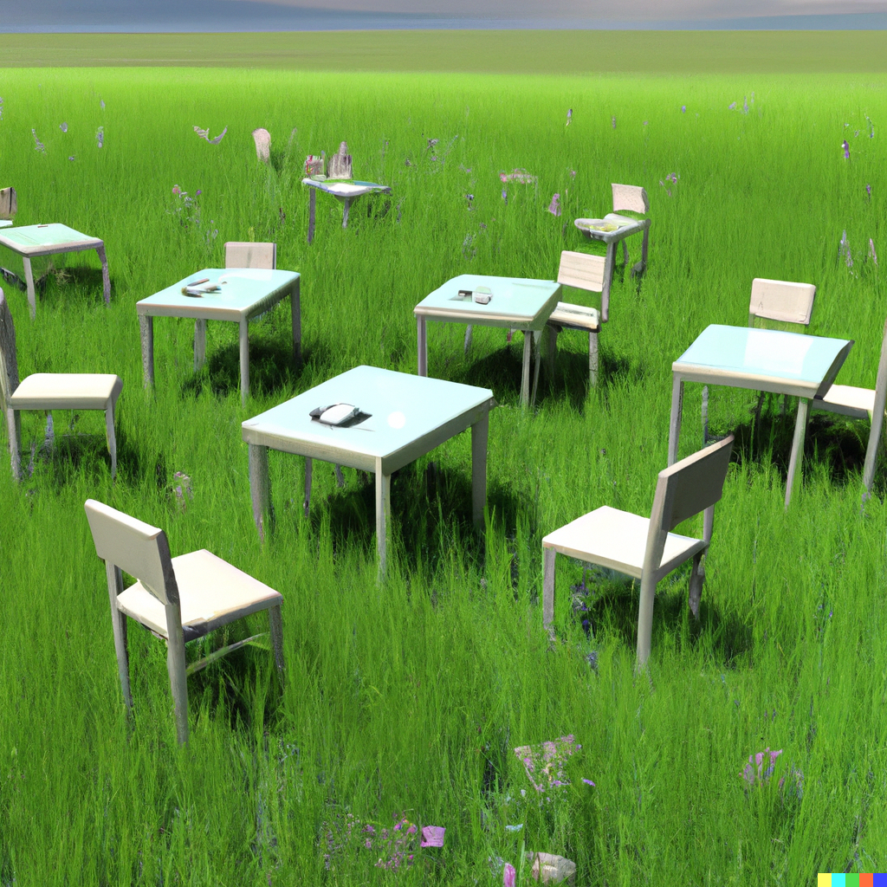
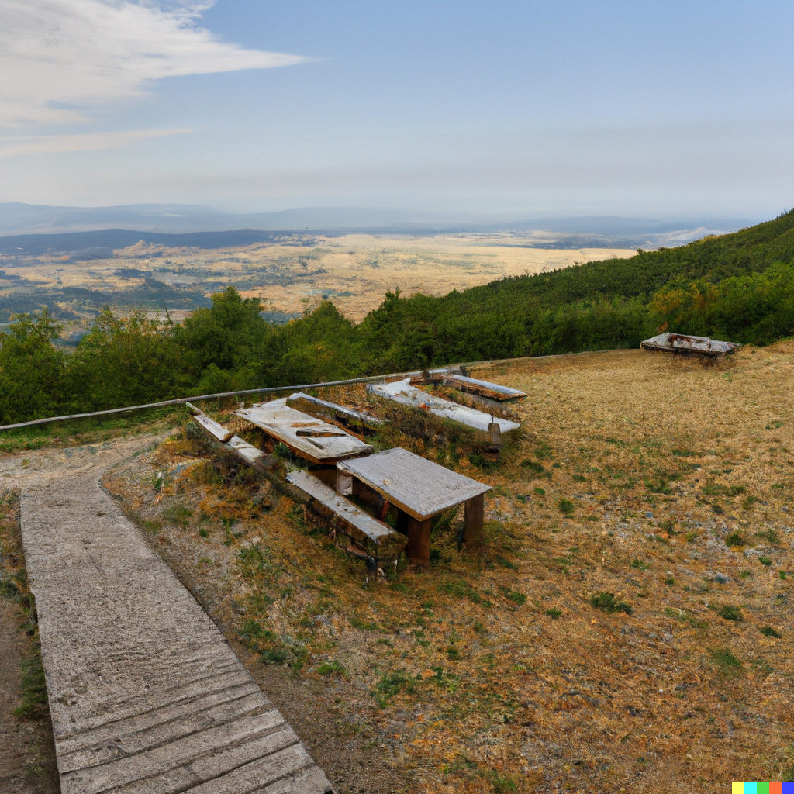
BREAK TIME!

Slide 24
Temporary Tables

Slide 25
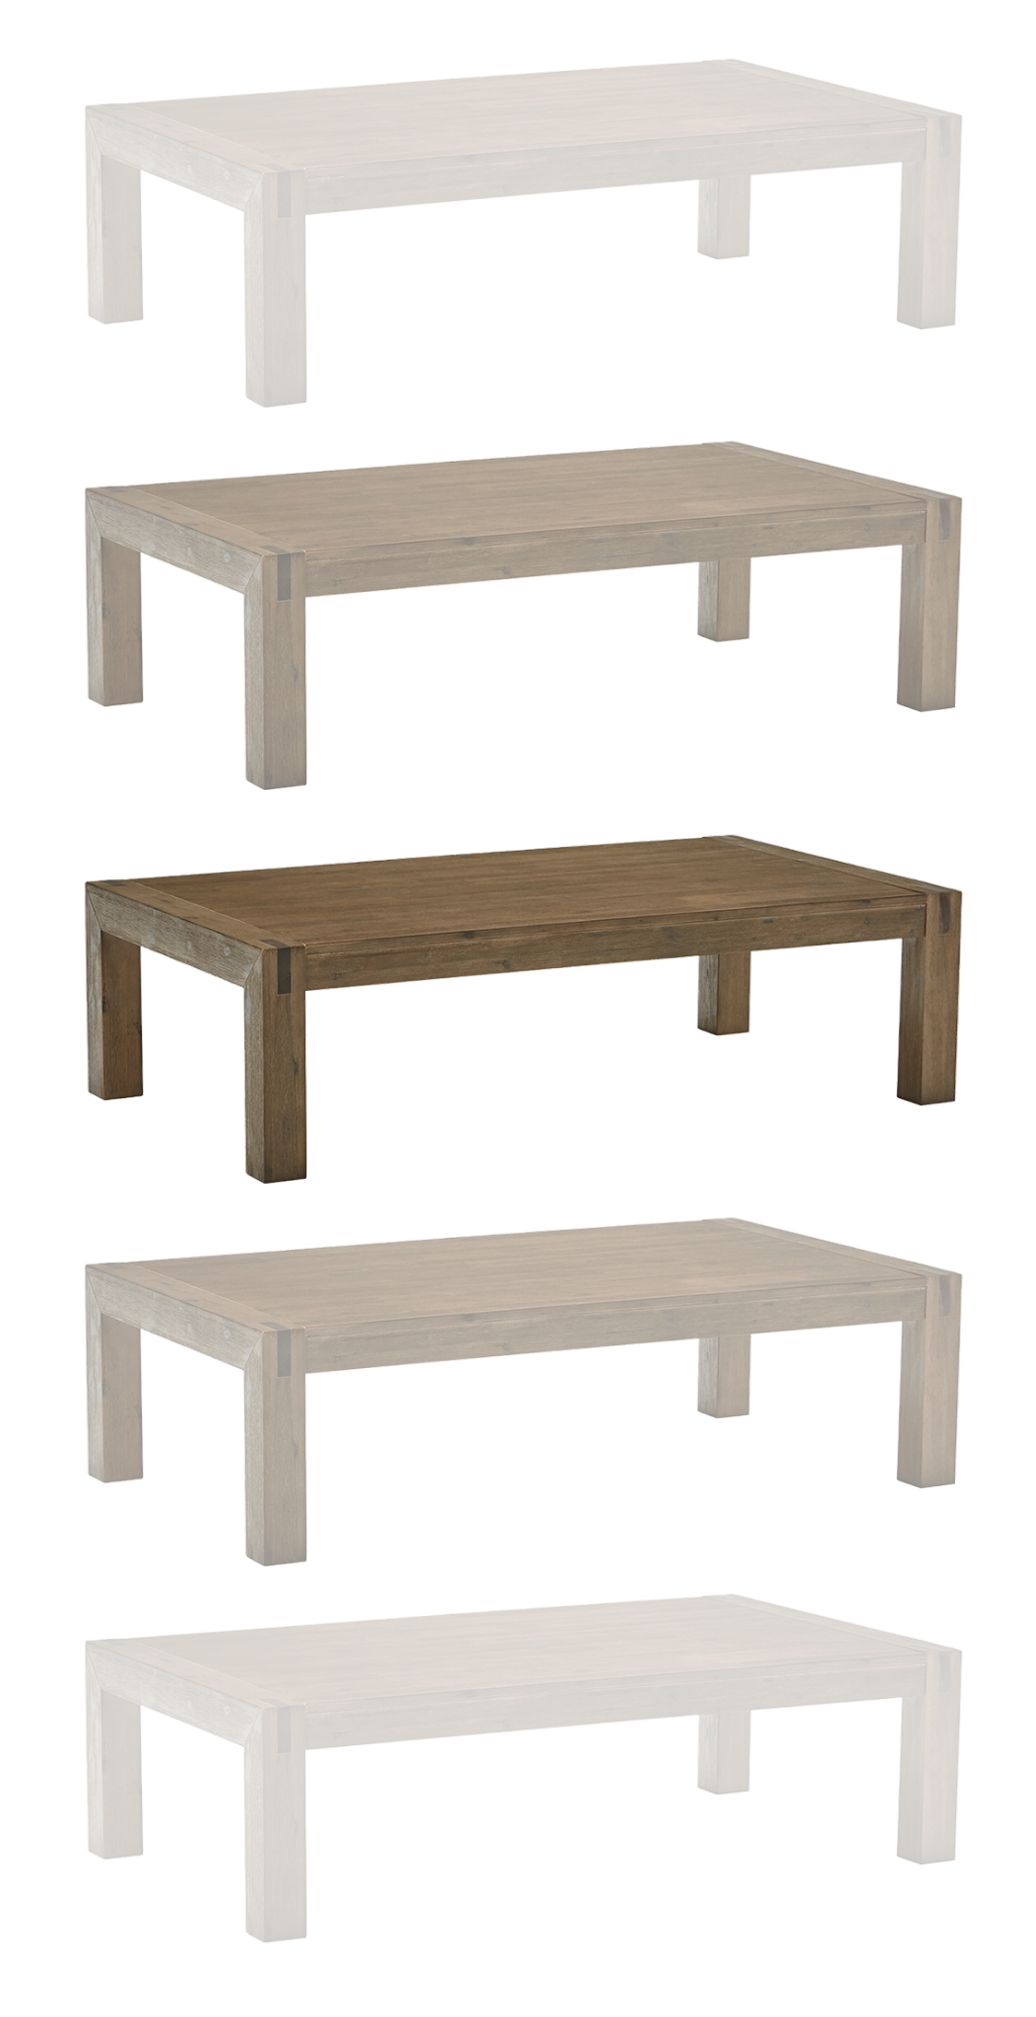
TEMPORARY TABLES
Tables that exist in a specific "session"
Useful for:
Breaking down complex queries into smaller, more manageable parts
Storing temporary data

Slide 26
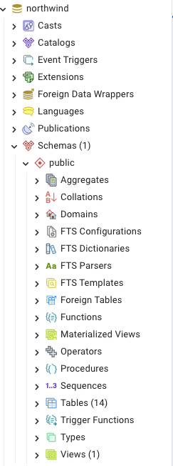



TEMPORARY TABLES
Notes:
Not accessible in sidebar; “temporary” in MySQL

Slide 27
Let’s practice Temporary Tables!

Slide 28
Common Table Expressions (CTEs)

Slide 29

REMEMBER NESTED QUERIES?
Can be hard to read and understand, especially when multi-layered
Notes:
Not accessible in sidebar; “temporary” in MySQL

Slide 30
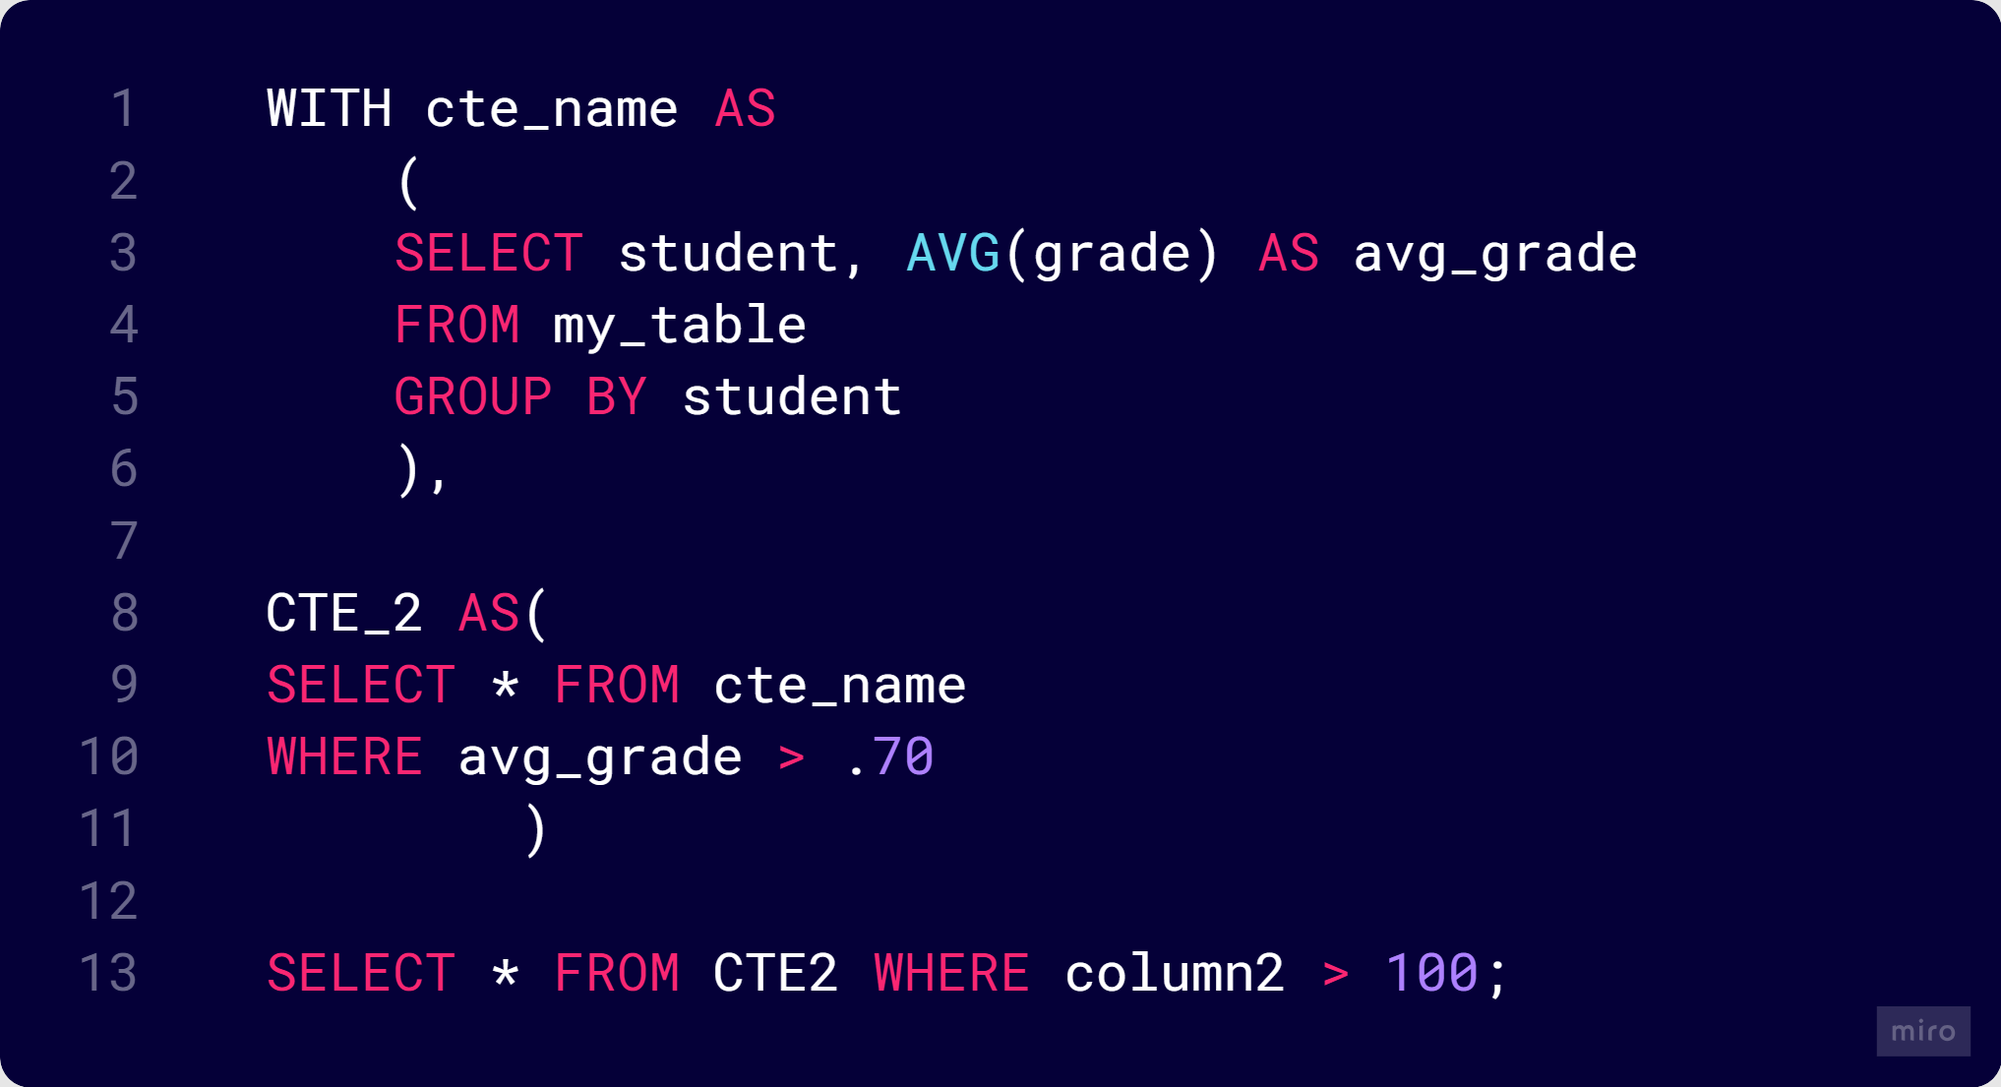
COMMON TABLE EXPRESSIONS (CTEs)
Improved readability
Reusable
Modular
Similar to temporary tables, but exist only during the execution of the query

Slide 31
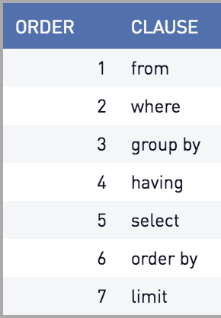
COMMON TABLE EXPRESSIONS (CTEs)
Notes:
Especially useful with filtering GROUP BY using WHERE because of order of execution

Slide 32
Let’s practice CTEs!

Slide 33
BEST PRACTICES
Consistent & meaningful naming conventions
FORMAT and indent code consistently
Use aliases for tables and columns
Use comments to explain complex logic
Break complex queries into subqueries (CTEs)
Minimize use of nested subqueries

Slide 34
Thank you!

